Slide 1

Graph and Session

Slide 2

Reference
Chapter 9 (O'Reilly) of Hands-On ML
Youtube
Code

Slide 3
Warm Up

Slide 4
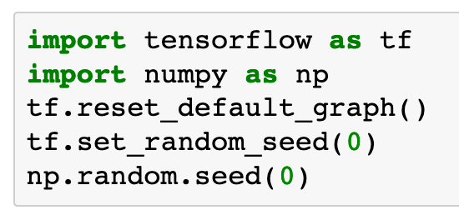

Slide 5
Graph

Slide 6
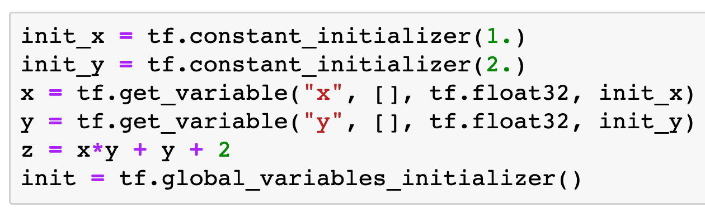

Slide 7
Session

Slide 8
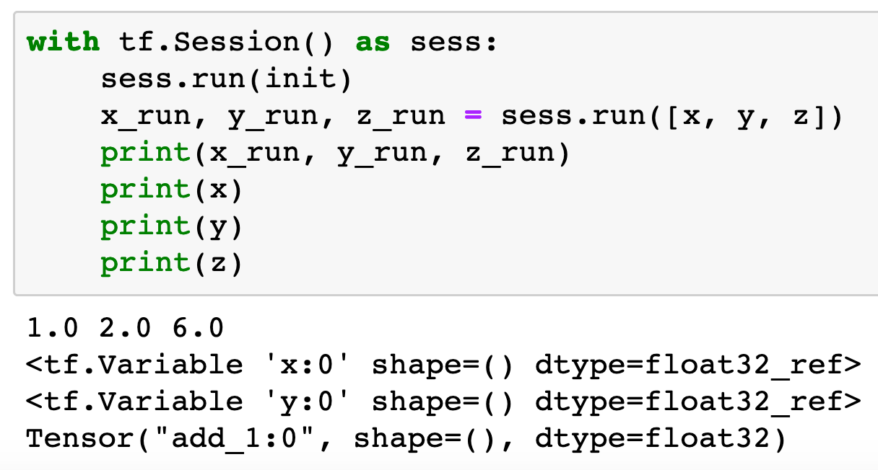

Slide 9
Now
Let’s Play with Code

